Slide 1
Sindhuli Society Of America
Power Point Presentation – Account Sign up and Membership Instructions
By Arjun Kafle
General Secretary

Slide 2
Homepage – Desktop View
Notes:
Sindhuli Society of America Account Sign Up Continue..

Slide 3
Homepage – Mobile View
Notes:
Sindhuli Society of America Account Sign Up Continue..

Slide 4
Short Introduction of SSA
About SSA
Notes:
Sindhuli Society of America .. Continue

Slide 5
How to sign up An Account?
1. Please Launch SSA website www.sindhulisamajusa.org
2. Click an image option top right side corner of the homepage. Please refer yellow Arrow on below screen shot.
3. Once you click there it will launch login page .. For the first time users please click Need an account? Option
Notes:
Sindhuli Society of America Account Sign Up Continue..

Slide 6
Sign up .. Continue
4. Enter your Email address
5. Enter Your Desire password and confirm password
6. Then Click create account options
Notes:
Sindhuli Society of America Account Sign Up Continue..

Slide 7
Sign up Continue
7. Please check your inbox, you should receive an email to verify your email address. Similar as below,
8. Please click below blue link to verify your email.
Notes:
Sindhuli Society of America Account Sign Up Continue..

Slide 8
Sign up .. Continue
9. Once you click there it will take you to the login page, where you could see email verified notifications
10 . Enter your email address and Password you have created before. (same email)
Notes:
Sindhuli Society of America Account Sign Up Continue..

Slide 9
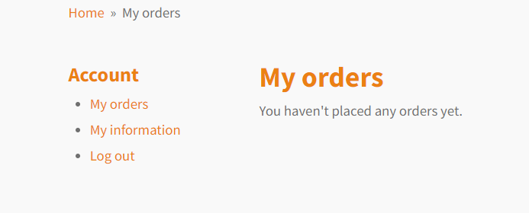
Sign up .. Continue
11.Once you are login please click My information option and update your details
Notes:
Sindhuli Society of America Account Sign Up Continue..

Slide 10
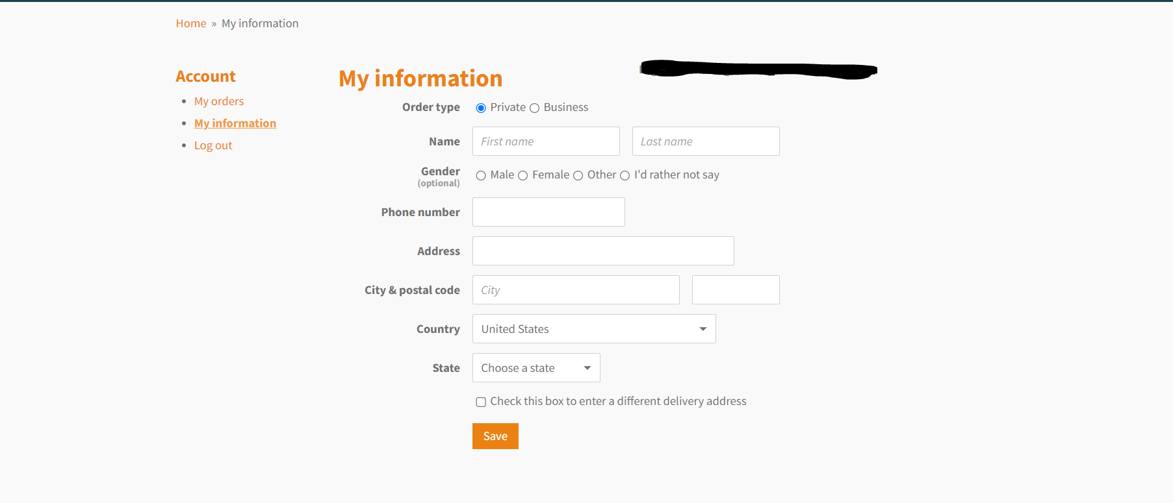
Sign up .. Continue
12. Please do not click below yellow arrowed box, it will ask to fill up same details.
Notes:
Sindhuli Society of America SSA Membership continue..

Slide 11
How to purchase Membership or send donation?
1. Click SSA Membership and Donations Tab on the Top of the homepage
2. Select your desire membership
Annual Membership -$15
Life-Time Membership - $150
Donations - $5 or any amount ( you can select any numbers while adding in your cart and $5 will be multiplied by that select numbers
Notes:
Sindhuli Society of America SSA Membership continue..

Slide 12
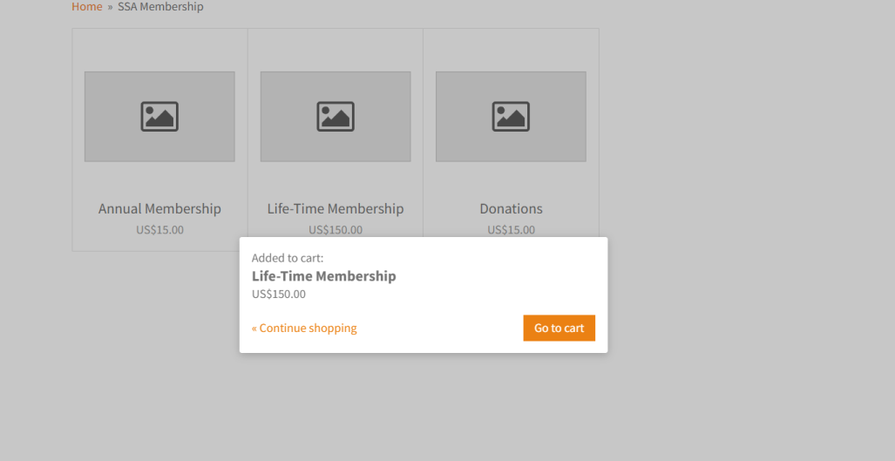
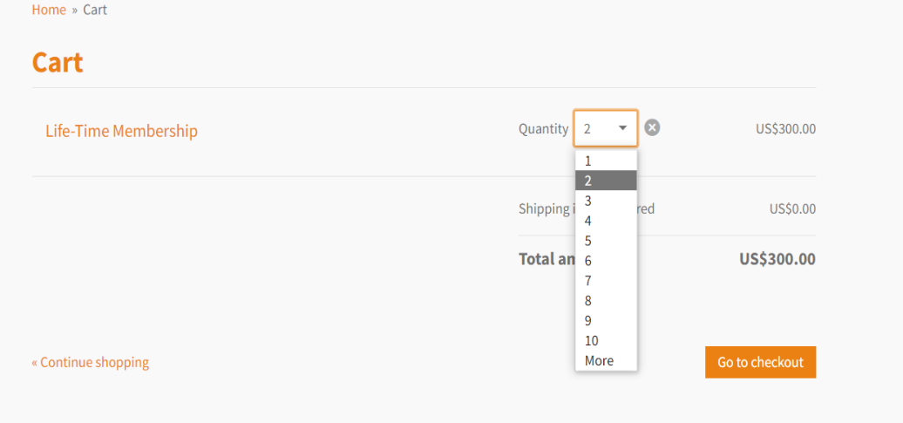
Membership or donation Continue..
3. Click go to Cart option below, once your cart is launched please select the quantity if you are planning to purchase for multiple people. Then Click Go to checkout option
Notes:
Sindhuli Society of America SSA Membership continue..

Slide 13
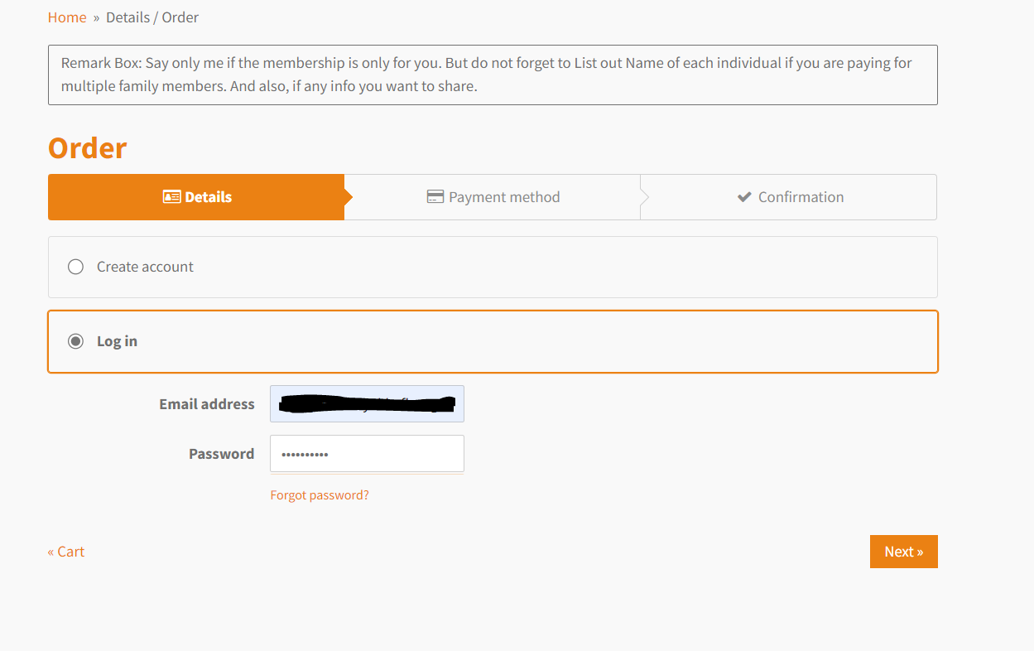
Membership or donation Continue..
4. Click Log in option if you already have an account if not then create an account
Notes:
Sindhuli Society of America SSA Membership continue..

Slide 14
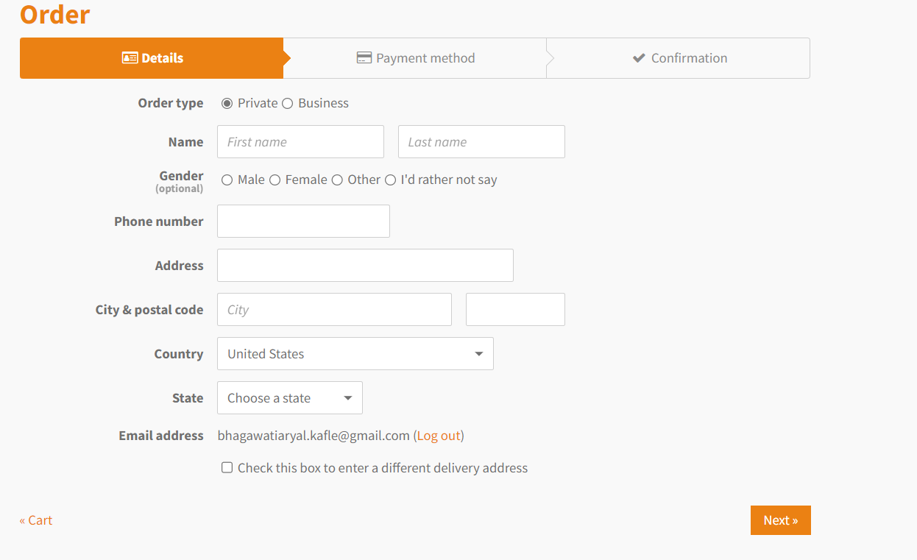
Membership or donation Continue..
5. Fill up below details and Click Next
Notes:
Sindhuli Society of America SSA Membership continue..

Slide 15
Membership or donation Continue..
6. Since we are using zelle(Quick Pay) as a payment method no need to fill up any payment details here.
Now Click Next

Slide 16
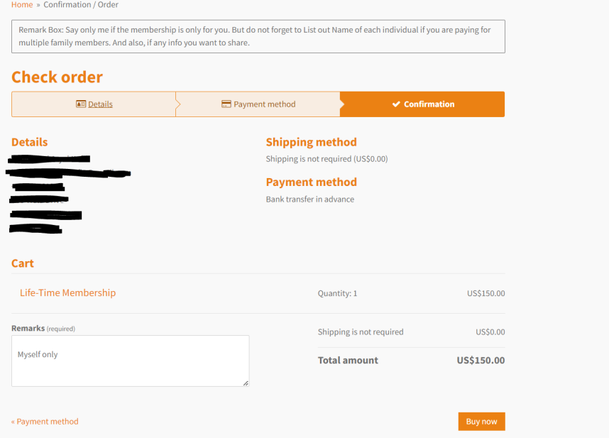
Membership or donation Continue..
7. Check Your order Conformation page, in Remark box please mention if you paying for you alone say myself or if it is for multiple persons please give everyone's name there. Now Click buy now

Slide 17
Membership or donation Continue..
8. Final Page ,
Notes:
Sindhuli Society of America SSA Membership continue..

Slide 18
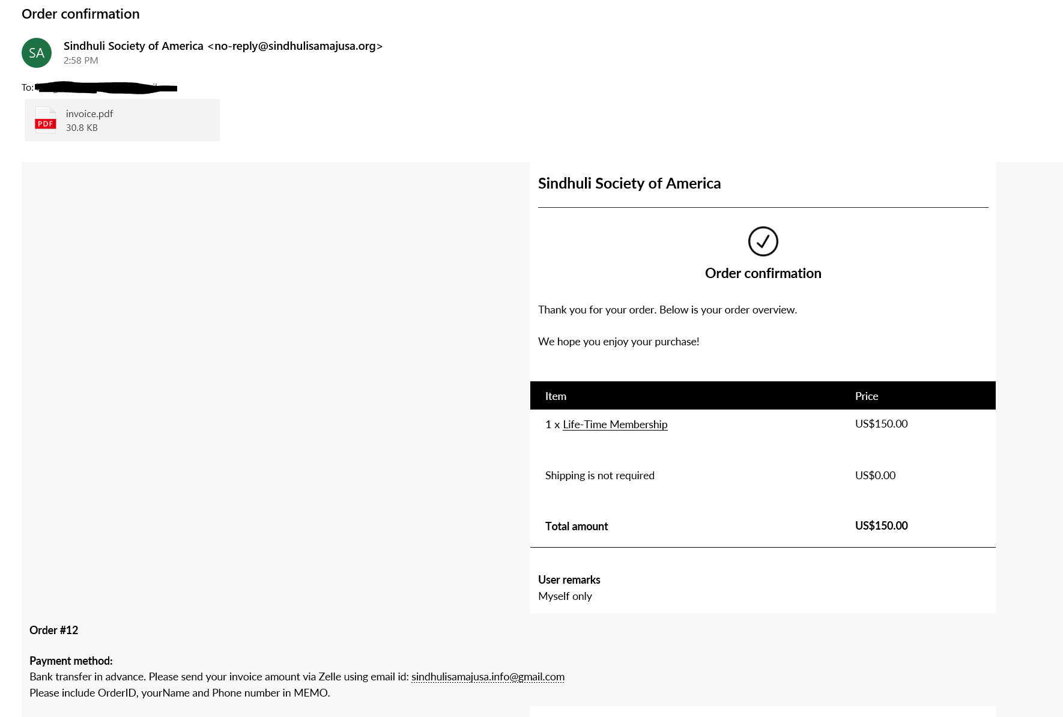
Membership or donation Continue..
9. Please check your inbox for payment instructions. Please send Payment via Zelle using our organization’s email Id.
Notes:
Sindhuli Society of America SSA Membership continue..

Slide 19
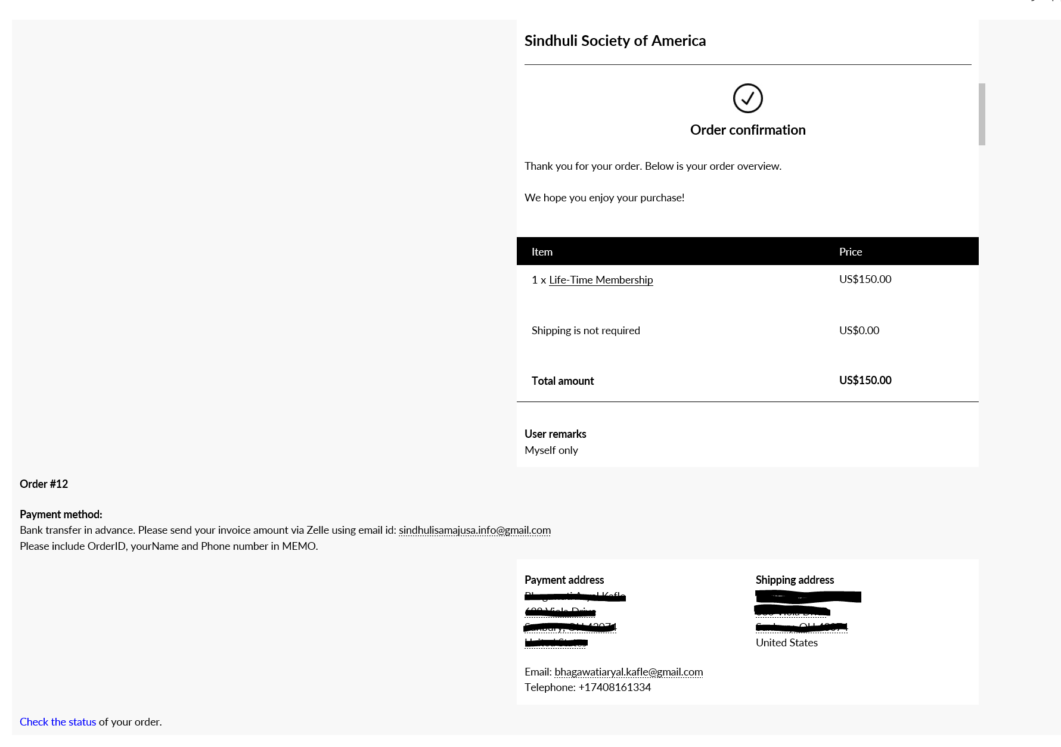
Membership or donation Continue..
10. you can check payment status by clicking below blue link
Notes:
Sindhuli Society of America SSA Membership continue..

Slide 20
Finally !!
Thank you for Joining us. Please share your
valuable feedback via Facebook page or website.
The End!!

